Slide 1
Open Source UI Automation on C#

Slide 2


ROMAN IOVLEV
Chief QA Automation
In Testing more than 11 years
In Testing Automation 9 years
Notes:
Работаю в компании Epam в

Slide 3
?

Slide 4





Jdi setup
https://github.com/epam/JDI
http://jdi.epam.com/
https://vk.com/jdi_framework
README

Slide 5
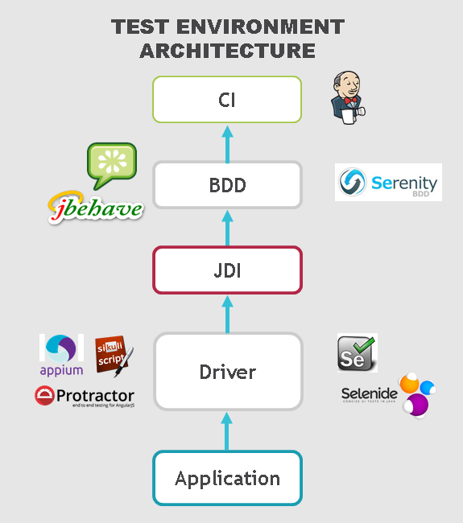
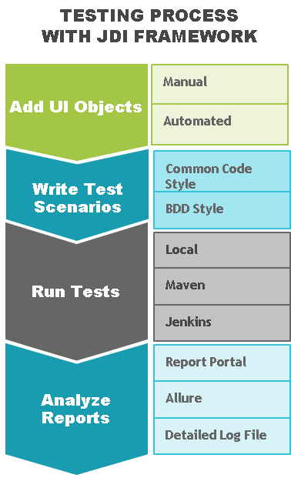
FAQ

Slide 6
SIMPLE TEST
ProductPage.ProductType.Select(«jacket»);
ProductPage.Price.select(«500$»);
ProductPage.Colors.check(«black», «white»);
Assert.isTrue(ProductPage.Label.getText(),
«Armani Jacket»)

Slide 7
SIMPLE TEST
LoginPage.Open();
LoginPage.LoginForm.Login(admin);
SearchPage.Search.Find(«Cup»);
Assert.AreEqual(ResultsPage.Products.Count(), expected);

Slide 8
Page elements

Slide 9
Tests
Page Objects
Driver (Engine)
Application
PAGE OBJECTS
ELEMENTS
private IWebElement UserName; private IWebElement Password; private IWebElement LoginButton;
ACTIONS
EnterUserName(String name);
EnterPassword(String name);
ClickLoginButton();
BUSINESS ACTIONS
Login(User user)

Slide 10
PAGE ELEMENTS
ELEMENTS
public TextField UserName; public TextField Password; public Button LoginButton;
ELEMENT
public DropDown UserStatus;
ACTIONS
Select(string option)
boolean IsSelcted()
List<String> AllOptions()
string GetValue()
ACTIONS
---
BUSINESS ACTIONS
Login(User user)

Slide 11
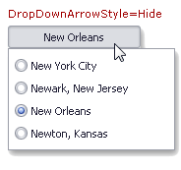
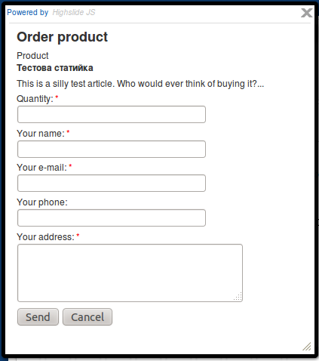

ELEMENTS
Simple
Complex
Composite

Slide 12
Simple elements

Slide 13


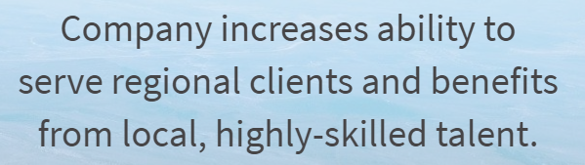
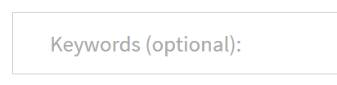
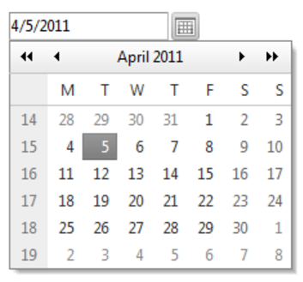



SIMPLE ELEMENTS
[FindBy (Css=“.description”)]
public Text Description;
public Button Submit;
public Label ProductName;
public Link FollowMe;
public TextField Password;
public TextArea Abuse;
public CheckBox RememberMe;
public DatePicker Date;
public FileInput Upload;
public Image Photo;
NEWS

Slide 14
SIMPLE ELEMENTS
[FindBy(Css=“.btn”) ]
public Button submit;
[FindBy(Css=“.btn”) ]
[FindBy(Xpath=“//button”) ]
[FindBy(Id=“button-id”) ]
[FindBy(Name=“button”) ]
[FindBy(Css=“.btn”) ]
public Button submit =
new Button(By.Css(“.btn”));
[FindBy(Css=“.btn”) ]
public IButton submit;

Slide 15
Multilocators
Multi language testing
Multi version testing
[JFindBy (text=“Submit”, group=“en”) ]
[JFindBy (text=“Отправить” , group=“ru”) ]
public Button submit;
[JFindBy(text=“Submit”, group=“1.7”) ]
[JFindBy(value=“Submit” , group=“2.0”) ]
public Button submit;

Slide 16


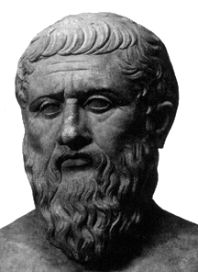

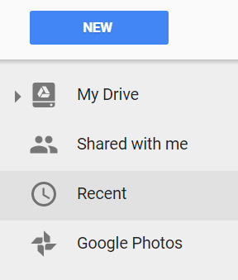

Plato's theory of Forms
IButton
No application but you can write UI Objects (Page Objects )
Notes:
Why we develop it?
Some people formulate it as “Why you create one more wheel”

Slide 17
complex elements

Slide 18
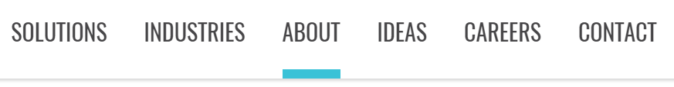
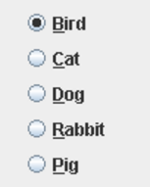
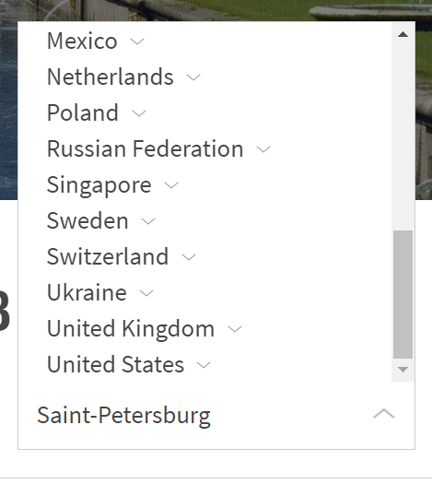
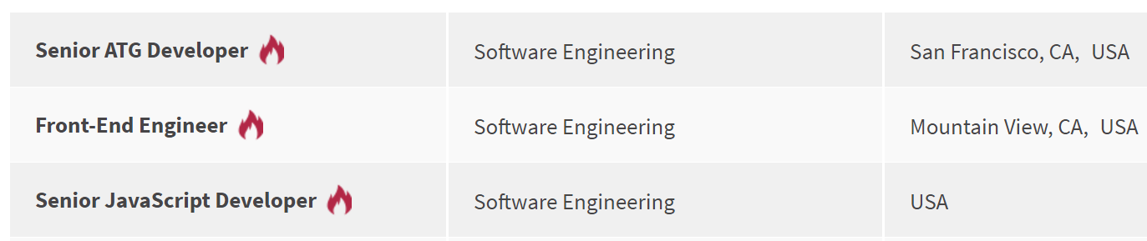
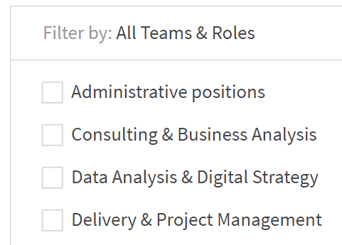
COMPLEX ELEMENTS
public Dropdown Colors;
public Checklist Settings;
public ComboBox Tags;
public DropList ShirtSizes;
public List<Element> SearchResults;
public Elements Reviews;
public Table Products;
public Menu MainMenu;
public Tabs Areas;
public Selector Vote;
public RadioButtons Rating;
public TextList Chat;

Slide 19
COMPLEX ELEMENTS
[FindBy (Css = “.colors") ]
public Dropdown colors = new Dropdown {
Value = By.Css(".value"),
List = By.TagName(“li")
};
[FindBy (Css = “.offers") ]
public Table offers = new Table {
Row = By.Css(".value"),
Column = By.TagName(“li"),
Header = new [] {“ID", “Title", “Apply”}
};

Slide 20
COMPLEX ELEMENTS
[FindBy (Css = “.colors") ]
public Dropdown Colors;
[FindBy (Css = “.table”) ]
public Table Offers;
[FindBy (Css = “.menu li”) ]
public Menu Navigation;
[FindBy (Css = “.menu ul”) ]
public Menu Navigation;
[FindBy (Xpath = “//*[@class=‘menu’]//li[text()=‘%s’]”) ]
public Menu Navigation;

Slide 21
TYPIFIED ELEMENTS
Code readability
Clear behavior
Union of all element’s locators
Union of element and its actions
Detailed logging

Slide 22
COMPARE
Text Description;
Button Submit;
Label ProductName;
Link FollowMe;
TextField Password;
TextArea Abuse;
CheckBox RememberMe;
DatePicker Date;
FileInput Upload;
Image Photo;
IWebElement Description;
IWebElement SubmitButton;
IWebElement ProductName;
IWebElement FollowMeLink;
IWebElement PasswordField;
IWebElement Abuse;
IWebElement RememberMe;
IWebElement DatePicker;
IWebElement Upload;
IWebElement Photo;

Slide 23
COMPARE
[FindBy(css = “.colors") ]
public Dropdown colors = new Dropdown {
Value = By.Css(".value"),
List = By.TagName(“li") };
[FindBy(Css = “.colors .value") ]
IWebElement ColorsValue;
[FindBy (Css = “.colors li") ]
List<IWebElement> ColorsList;
public string GetColor() {
return ColorsValue.GetText();
}
public void SelectColor(String ColorName) {
ColorsValue.Click();
for (IWebElement Color : ColorsList)
if (Color.getText().Equals(ColorName) {
Color.Click();
return;
}
}

Slide 24
COMPARE
[FindBy (Id = “trades") ]
public Table Colors;
[FindBy (Id = “…") ]
private List<IWebElement> ResultsColHeaders;
[FindBy (Id = “…") ]
private List<IWebElement> ResultsRowsHeaders;
[FindBy (Id = “…") ]
private List<IWebElement> ResultsCellsHeaders;
[FindBy (Id = “…") ]
private List<IWebElement> ResultsColumn;
[FindBy (Id = “…") ]
private List<IWebElement> ResultsRow;
ICell cell(Column column, Row row) { }
ICell cell(String columnName, String rowName) { }
ICell cell(int columnIndex, int rowIndex) { }
List<ICell> cells(String value) { }
List<ICell> cellsMatch(String regex) { }
ICell cell(String value) { }
ICell cellMatch(String regex) { }
MapArray<String, MapArray<String, ICell>> rows(String... colNameValues) { }
MapArray<String, MapArray<String, ICell>> columns(String... rowNameValues) { }
boolean waitValue(String value, Row row) { }
boolean waitValue(String value, Column column) { }
boolean isEmpty() { }
boolean waitHaveRows() { }
boolean waitRows(int count) { }
ICell cell(String value, Row row) { }
ICell cell(String value, Column column) { }
List<ICell> cellsMatch(String regex, Row row) { }
List<ICell> cellsMatch(String regex, Column column) { }
MapArray<String, ICell> row(String value, Column column) { }
MapArray<String, ICell> column(String value, Row row) { }
MapArray<String, ICell> row(int rowNum) { }
MapArray<String, ICell> row(String rowName) { }
List<String> rowValue(int colNum) { }
List<String> rowValue(String colName) { }
MapArray<String, ICell> column(int colNum) { }
MapArray<String, ICell> column(String colName) { }
List<String> columnValue(int colNum) { }
List<String> columnValue(String colName) { }
MapArray<String, SelectElement> header() { }
SelectElement header(String name) { }
List<String> headers() { }
List<String> footer() { }
List<ICell> getCells() { }
void clean() { }
void clear() { }
ITable useCache(boolean value) { }
ITable useCache() { }
Table clone() { }
Table copy() { }
ITable hasAllHeaders() { }
ITable hasNoHeaders() { }
ITable hasOnlyColumnHeaders() { }
ITable hasOnlyRowHeaders() { }
ITable hasColumnHeaders(List<String> value) { }
<THeaders extends Enum> ITable hasColumnHeaders(Class<THeaders> headers) { }
ITable hasRowHeaders(List<String> value) { }
<THeaders extends Enum> ITable hasRowHeaders(Class<THeaders> headers) { }
ITable setColumnsCount(int value) { }
ITable setRowsCount(int value) { }

Slide 25
Composite elements

Slide 26
composite Elements
public class Header : Section
[JPage (Url = "/index.html", Title = “Good site") ]
public class HomePage : WebPage
[JSite (Domain = “http://epam.com/") ]
public class EpamSite : WebSite
public class LoginForm : Form
public class SearchBar : Search
public class Alert : Popup
public class Navigation : Pagination

Slide 27
WEB site
[JPage (domain = “http://epam.com/") ]
public class EpamSite : WebSite {
[JPage (Url = "/index.html") ]
public static HomePage homepage;
[JPage (Url = "/login", Title = “Login page") ]
public static LoginPage loginPage;
[FindBy (Сss=“.nav”) ]
public static Menu navigation;
}
public static void SetUp() {
WebSite.Init(typeof(EpamSite));
}

Slide 28
WEB PAGE
[JPage (Url = "/main", Title = "Good site", UrlTemplate = “/main?\d{10}“, UrlCheckType = MATCH, TitleCheckType = CONTAINS) ]
public class HomePage : WebPage
USAGE
homepage.Open();
homepage.CheckOpened();
homepage.IsOpened();
homepage.Refresh();
homepage.Back();
homepage.Forward();
homepage.AddCookie();
homepage.ClearCache();

Slide 29
Section
public class Header : Section {
[FindBy (Сss=“.submit”) ]
public Button submit;
[FindBy (Сss=“.followMe”) ]
public Link followMe;
[FindBy (Сss=“.navigation”) ]
public Menu navigation;
public void openAbout() {
followMe.Click();
navigation.Select(ABOUT);
}
}
USAGE
header.Submit.Click();
header.Menu.IsSelected();
header.OpenAbout();

Slide 30
Entity driven testing

Slide 31






EDT: DATA DRIVEN TESTING
Provide List<User> for test

Slide 32


EDT: PRECONDITIONS
Provide List<User> for test
0. Have DefaultUser in DB
?
+

Slide 33

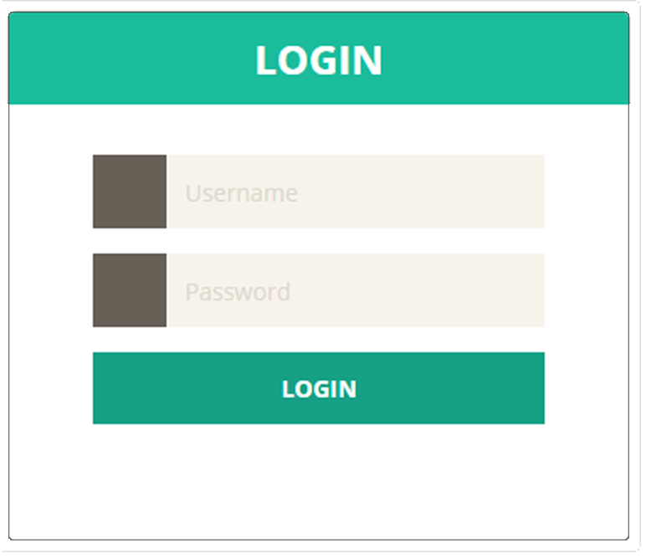
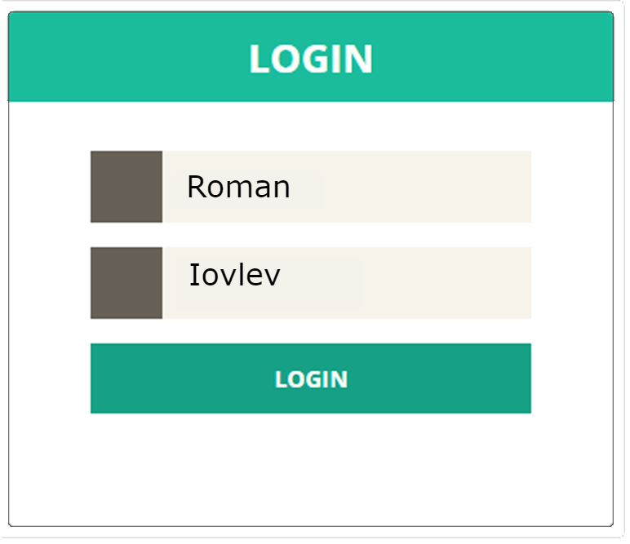
EDT: FILL AND SUBMIT
Provide List<User> for test
0. Have DefaultUser in DB
Login with DefaultUser

Slide 34

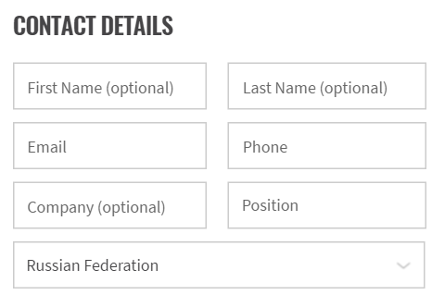
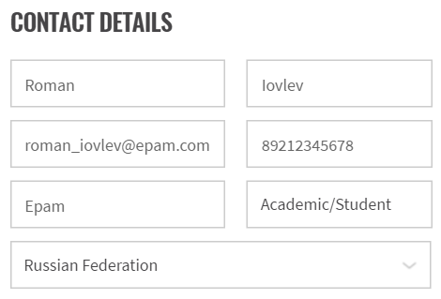
EDT: FILL AND SEND
Provide List<User> for test
0. Have DefaultUser in DB
Login with DefaultUser
Submit Contact Us Form for DefaultUser

Slide 35

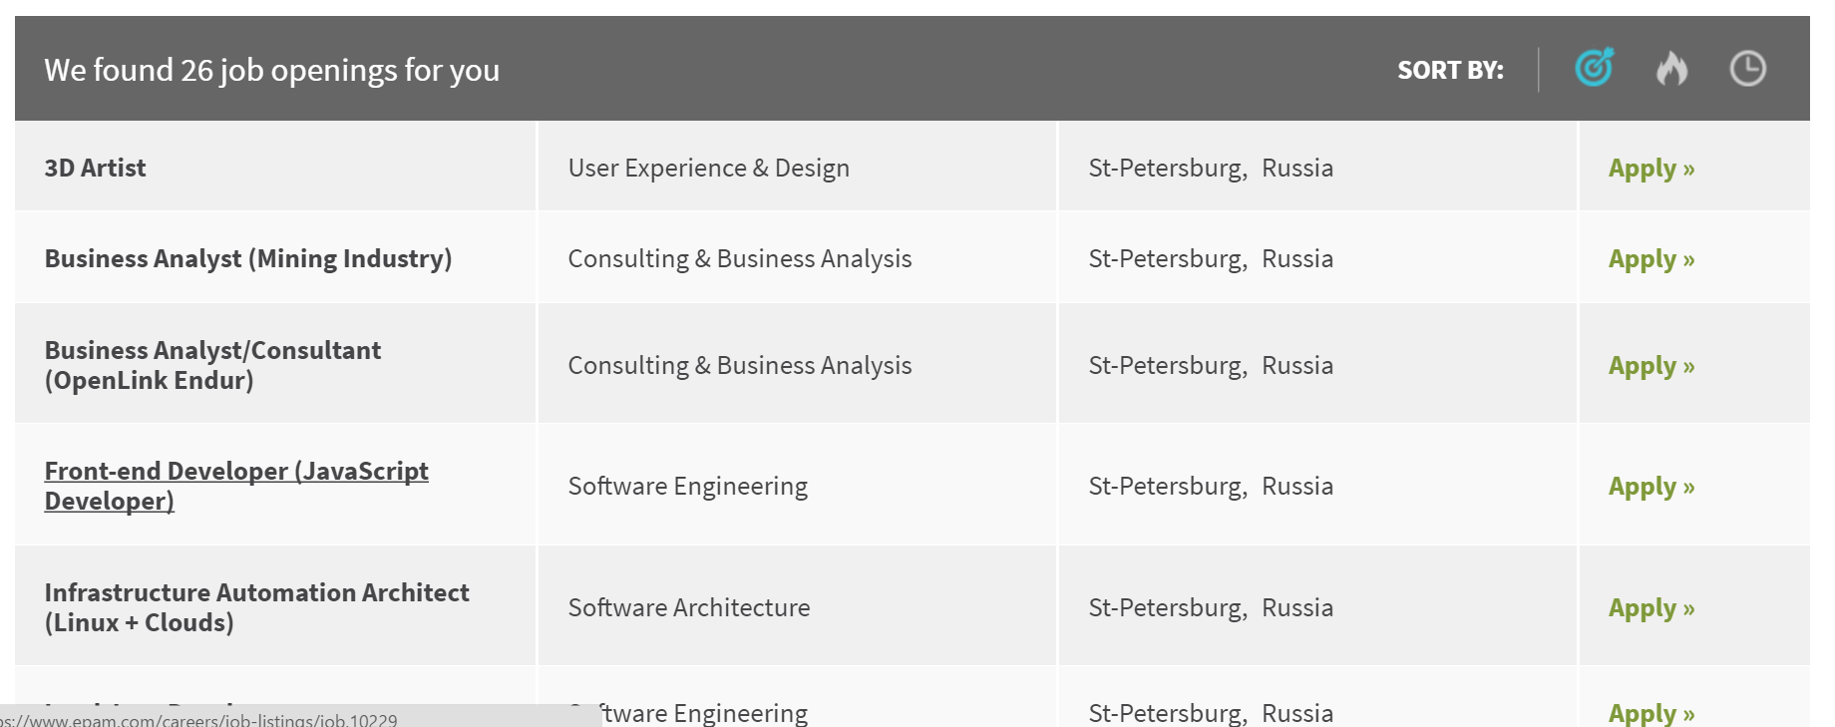

EDT: EXTRACT
Provide List<User> for test
0. Have DefaultUser in DB
Login with DefaultUser
Submit Contact Us Form for DefaultUser
Get Act. Opening from Vacancy table

Slide 36

EDT: VALIDATE
Provide List<User> for test
0. Have DefaultUser in DB
Login with DefaultUser
Submit Contact Us Form for DefaultUser
Get Act. Opening from Vacancy table
Assert Act. Opening equals to Exp. Opening
Actual
Expected

Slide 37
FORM
public class LoginForm extends Form<User> {
[FindBy (Сss=“.login”)
public TextField Login;
[FindBy (Сss=“.psw”)
public TextField Password;
[FindBy (Сss=“.submit”)
public Button Submit;
[FindBy (Сss=“.cancel”)
public Button Cancel;
}
public class User {
public String Login = “roman”;
public String Password = null;
}
[Test]
public class SimpleTest(User User) {
loginForm.login(user);
…
}

Slide 38
Entity driven testing
[Test]
public void FormTest(User Admin) {
LoginForm.LoginAs(Admin);
Filter.Select(Admin.name);
Assert.Each(Results).Contains(Admin.Name);
Results.get(1);
PayForm.Submit(Admin.CreditCard);
Assert.AreEquals(DB.Transactions[1]),
Admin.CreditCard);
}
USAGE
LoginForm.Fill(User);
LoginForm.Submit(User);
LoginForm.Verify(User);
LoginForm.Check(User);
LoginForm.Cancel(User);
LoginForm.Save(User);
LoginForm.Publish(User);
LoginForm.Search(User);
LoginForm.Update(User);
…

Slide 39
[FindBy (Css = “.offers") ]
public Table<Job, JobRecord> Offers = new Table {
Row = By.Css(".value"),
Column = By.TagName(“li"),
Header = new [] {“ID", “Title", “Apply”}
};

Slide 40
elements
[FindBy (Css = ".list.ui-sortable") ]
public Elements<FilmCard> FilmCards;
FilmCards[name].Title.GetText();

Slide 41
Other UI objects
public class SearchBar : Search { }
public class Navigation : Pagination { }
public class Confirmation : Popup { }
…
public class MyCustom : CustomObject { }
// implements IComposite

Slide 42
Ui objects pattern

Slide 43

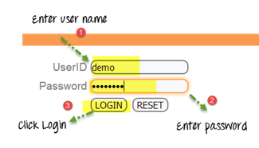
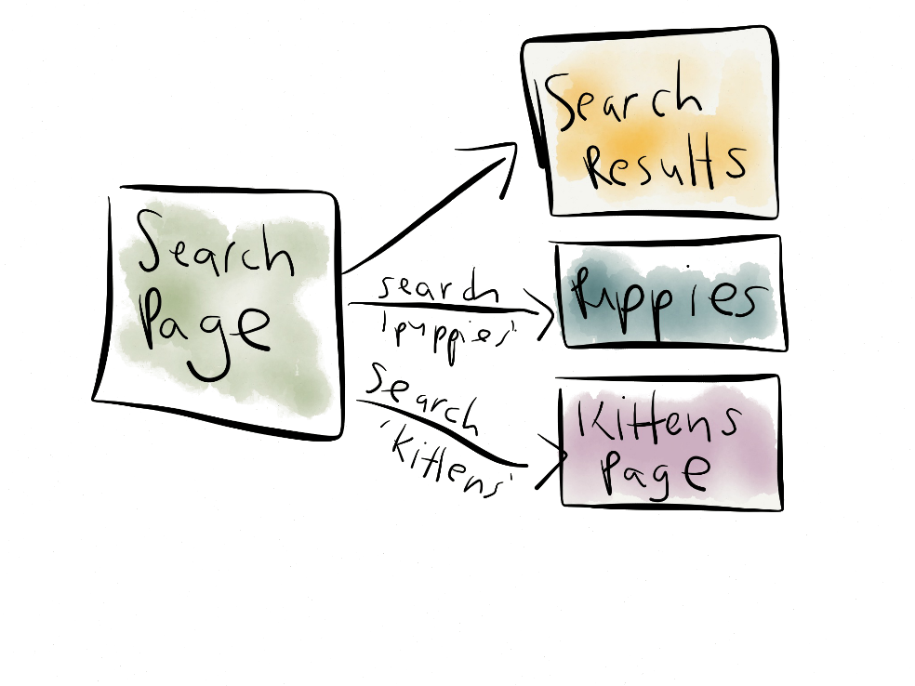
UI Objects
Popular test pattern
Page Objects

Slide 44
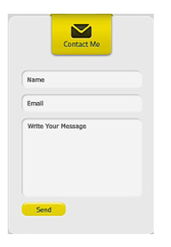


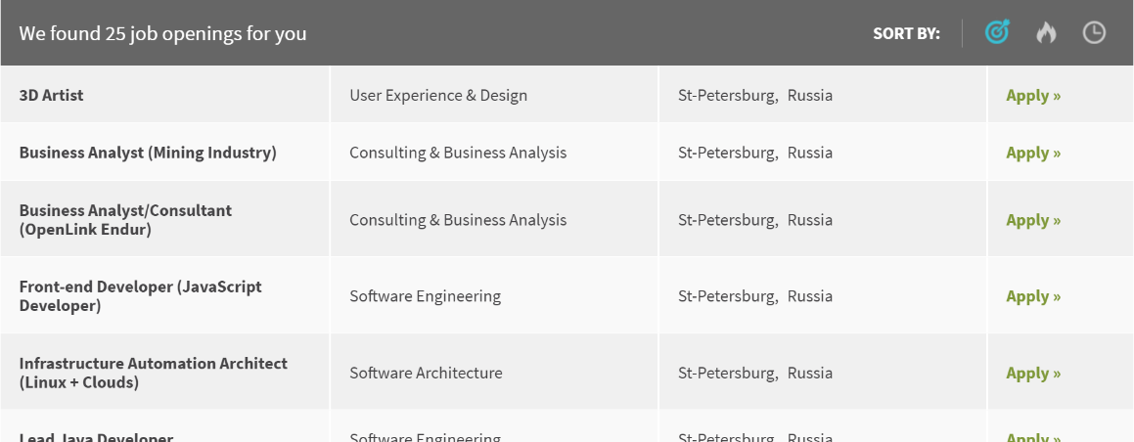
UI Objects
Useful test approach
UI Elements

Slide 45



UI Objects
Flexible implementation
Interfaces

Slide 46
UI Objects
Page Objects
UI Elements
UI OBJECTS
Interfaces

Slide 47
interfaces

Slide 48




Test Any UI
Your Engine (Driver)

Slide 49
JDI architecture
Commons
Matchers
IElement
ISelector
IComposite
IPage
IHasValue
ISetValue
Core
Web, Mobile, Gui …
IButton
ICheckBox
IDatePicker
IFileInput
IImage
ILabel
ILink
IText
ITextArea
ITextField
ICheckList
IComboBox
IDropDown
IDropList
IForm
IGroup
IMenu
IPage
IPagination
IPopup
IRadioButtons
ISearch
ISelector
ITabs
ITextList
INTERFACES
public interface ICheckBox
extends IClickable, ISetValue {
void Check();
void Uncheck();
boolean IsChecked();
}

Slide 50
For business

Slide 51
JDI benefits
Write test code faster up to 5 times
Average result around 2.8 times
4.7 times speedup on the project with standard implementation
Produce less amount of test code (loc) up to 3 times
Average result around 2.1 times
2.8 times reduction on the project with standard implementation
Achieve higher clearness of tests
Decrease of support time for test projects
Lowering of project entry barrier for newcomers
Complete projects with higher quality
Based on 70 % answers in survey

Slide 52
JDI benefits
Reuse investments from one Project on another
Based on 5 years of work and more than 30 projects that already use JDI
Save up to 80% test effort by migrating tests to other Platforms
Based estimated average scope reductions for all test process stages
Example: migrate Web tests to Mobile platform
Can be used in most of projects with UI Automation
Actually we have no projects where JDI is not applicable. The only reason why not all of our projects use JDI is Client requirements
Save up to 30-40% money from whole test process
Based on average calculation of scope reductions for all test process stages

Slide 53
FUTURE

Slide 54
Log in bdd style
ProductPage.ProductType.select(«jacket»);
ProductPage.Price.select(«500$»);
ProductPage.Colors.check(«black», «white»);
I select ‘jacket’ ProductType on ProductPage
I select ‘500$’ Price on ProductPage
I check ‘black’ and ‘white’ Colors on ProductPage

Slide 55
Generated page objects
Chrome plugin
Get ui elements to page object in browser
Auto generation
public class LoginForm extends Form<User> {
@FindBy (css=“.login”)
public TextField login;
@FindBy (css=“.psw”)
public TextField password;
@FindBy (css=“.submit”)
public Button login;
}

Slide 56
Services page objects
@ServiceDomain(“http://service.com”)
public class ServiceExample {
@GET (“/color/get”)
public RestMethod getColor;
@POST (“/color/change/100”)
public RestMethod changeColor;
}
Auto generation by WSDL

Slide 57
db testing support

Slide 58


simple tests generator

Slide 59




Support main ui dev frameworks

Slide 60

Performance / statistic

Slide 61

Sniff http requests

Slide 62


Support js / phyton

Slide 63

enjoy

Slide 64




Contacts
roman.Iovlev
roman_iovlev@epam.com
http://jdi.epam.com/
https://vk.com/jdi_framework
https://github.com/epam/JDI

